Slide 1
SINGLE LINEAR ASSIGNMENT
TUSHAR SHINDE

Slide 2
SINGLE REGRESSION
Simple Linear Regression is a statistical method to find relationship between two continuous variables. Out of the two variables present, one is independent variable and the other is dependent variable. Statistical relationship is not accurate in determining relationship between two variables. For example, relationship between height and weight.
This relationship is defined by the famous line equation which you would have learned in high school.
y = b0 + b1*x
where,
y is the dependent variable
x is the independent variable
b0 is the base value of the relationship
b1 is the slope of the line explaining the relationship between y & x.

Slide 3
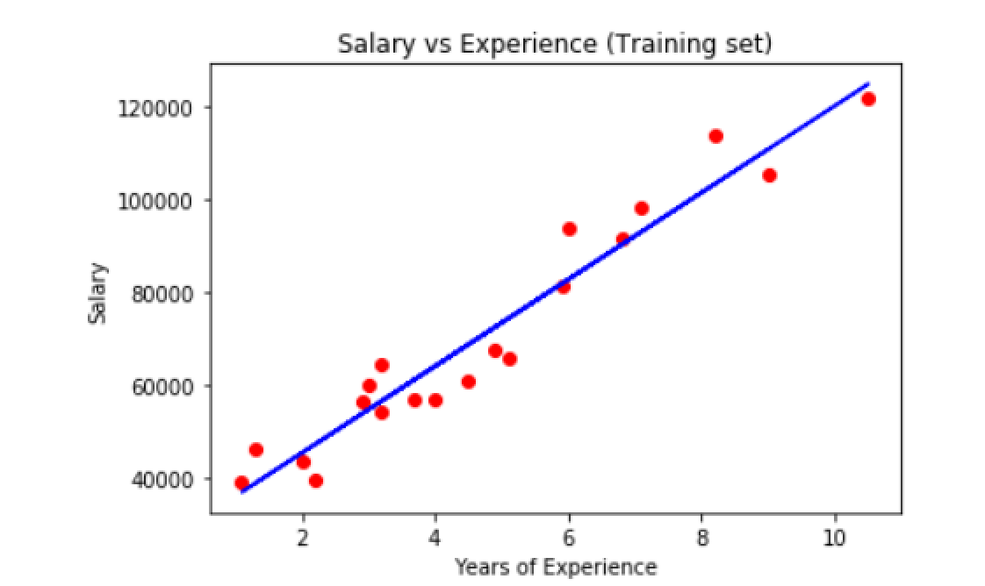
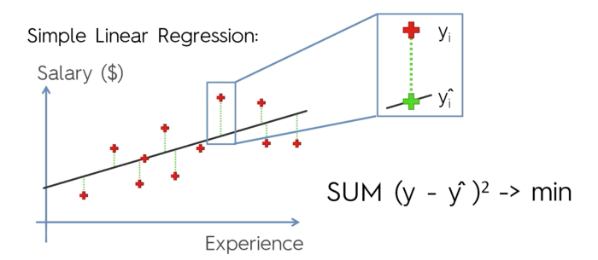
Point with red cross are actual or real data points, whereas points with green cross are predicted value of the regression model. The goal here is to make such a regression model that the sum of squared error is minimum.
For instance, y refers to how does a person’s salary change with the years of experience that he has. So in that case salary would be the dependent variable and experience will be the independent variable and the base value will the salary of a person who has no experience. In our code example, we are going to work on such a dataset.
In order to judge the actual correlation amongst the data, we are going to plot two curves.
In order to determine what is the best fitting line, let’s have a look at the following curve.
As it can be seen, the line we have here is not that bad, since only a few points lie very far from it, most of the points lie around the line itself.

Slide 4
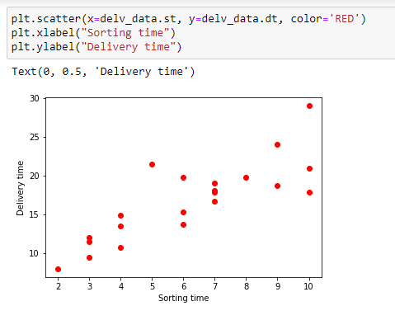
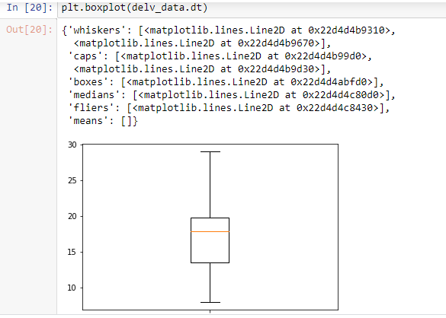
1) Delivery_time -> Predict delivery time using sorting time
Notes:
https://towardsdatascience.com/simple-linear-regression-in-python-8cf596ac6a7c

Slide 5
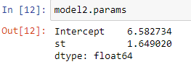

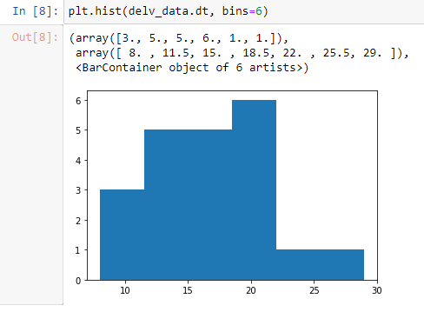
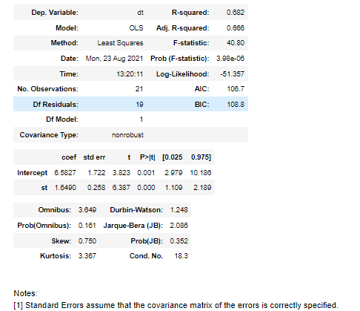

Slide 6

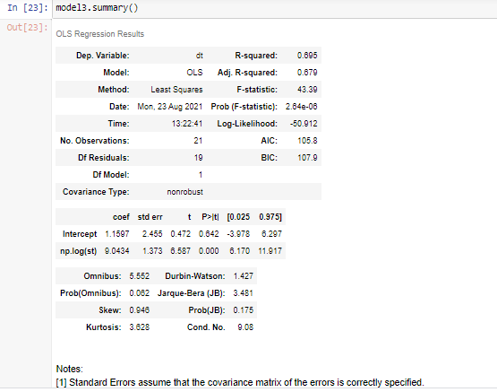

Slide 7
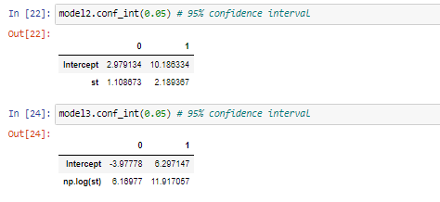
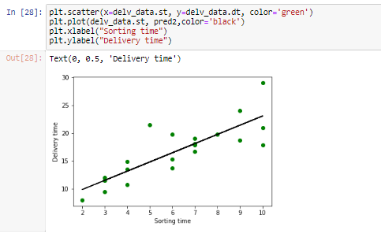
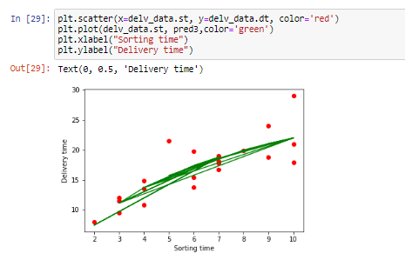
DATA SET
CODE

Slide 8
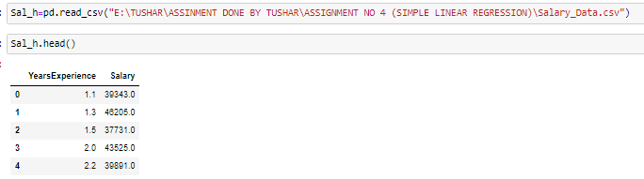
2) Salary hike -> Build a prediction model for Salary hike

Slide 9
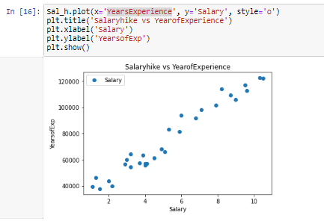
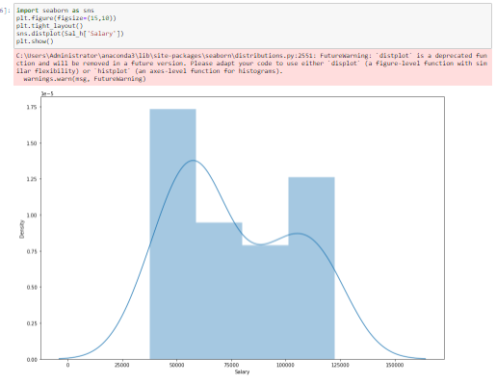

Slide 10
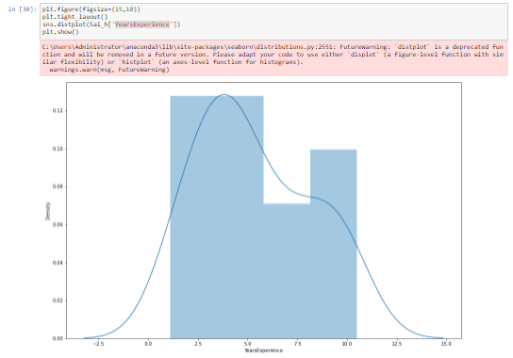
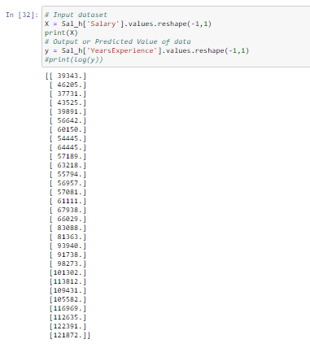

Slide 11
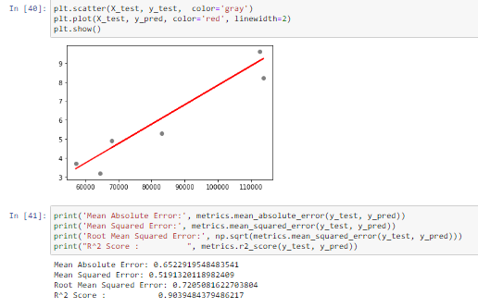
DATA SET
CODE

